Slide 1

COMPUTER NETWORKS
(BCSC 0008)
HTTP
Copyright content, use only with the written permission of presenter mentioned

Slide 2
Text and Reference Books
Text Books:
Fourouzan B. A. (2004), “Data Communication and Networking”, 4th Edition, McGraw-Hill.
References:
Kurose, J. F. and Ross K. W. (2005), “Computer Networking: A Top-Down Approach Featuring the Internet”, 3rd Edition, Addison-Wesley.
A. S. Tanenbaum (2006), “Computer Networks”, 2nd Edition, Prentice Hall India.

Slide 3
22.1 ARCHITECTURE
The WWW is a distributed client-server service, in which a client using a browser can access a service using a server. The service provided is distributed over many locations called sites.
The topics discussed in this section include:
Client (Browser)
Server
Uniform Resource Locator (URL)
Cookies

Slide 4
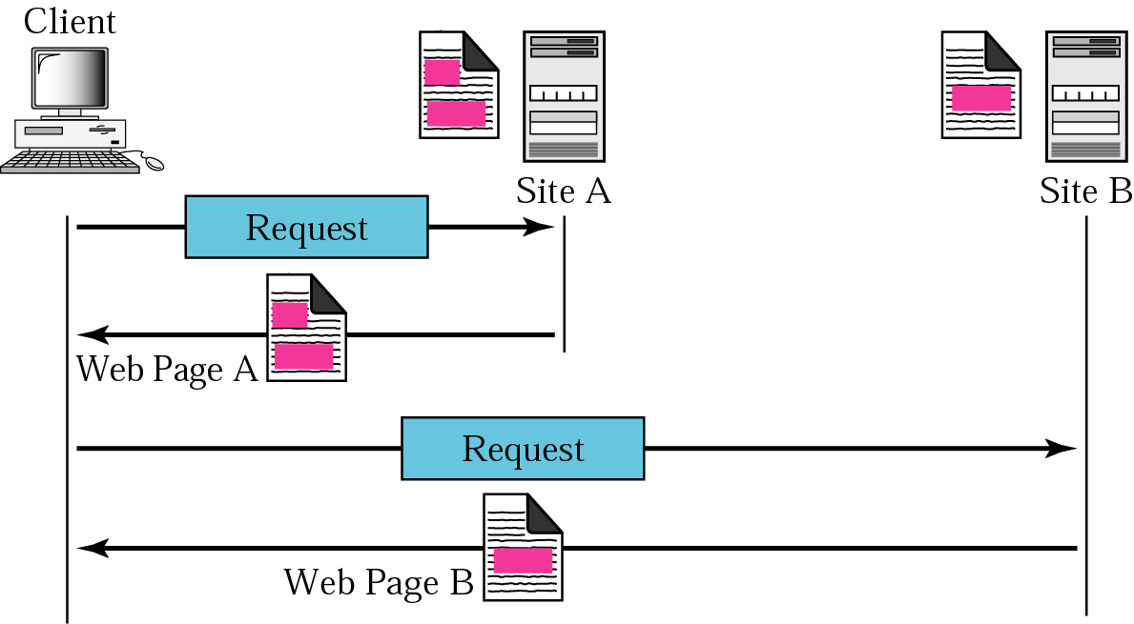
Figure 22.1 Architecture of WWW

Slide 5
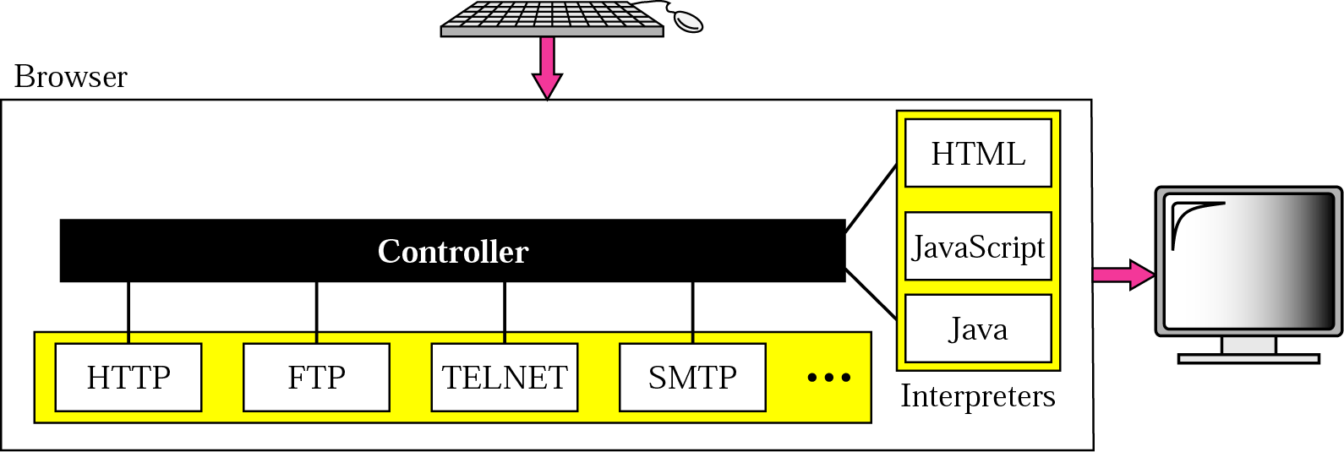
Figure 22.2 Browser

Slide 6
Figure 22.3 URL

Slide 7
22.3 HTTP
The Hypertext Transfer Protocol (HTTP) is a protocol used mainly to access data on the World Wide Web. HTTP functions like a combination of FTP and SMTP.
The topics discussed in this section include:
HTTP Transaction
Persistent versus Nonpersistent Connection
Proxy Server

Slide 8

Note:
HTTP uses the services of TCP on well-known port 80.

Slide 9
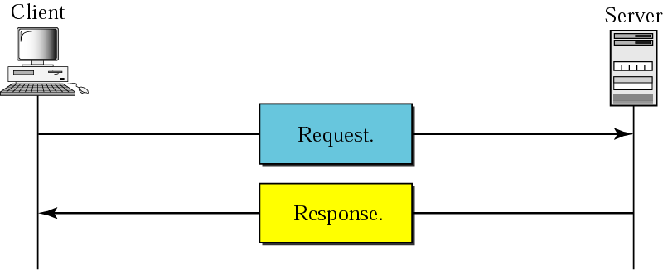
Figure 22.12 HTTP transaction

Slide 10
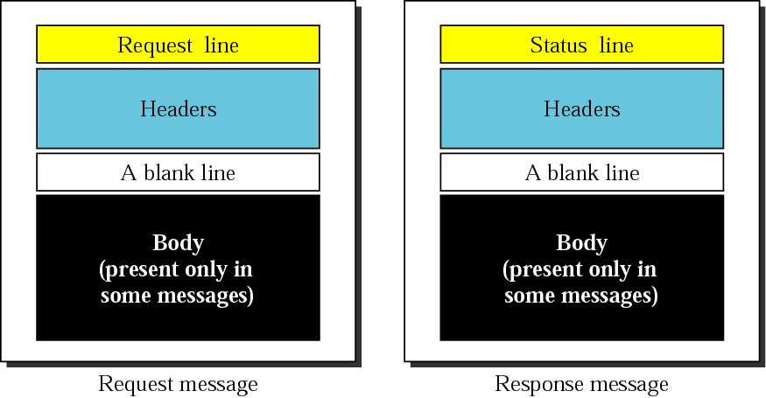
Figure 22.13 Request and response messages

Slide 11
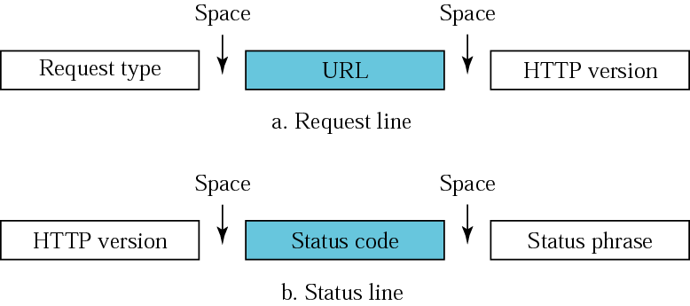
Figure 22.14 Request and status lines

Slide 12
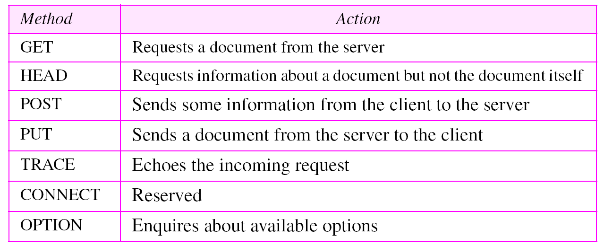
Table 22.1 Methods

Slide 13
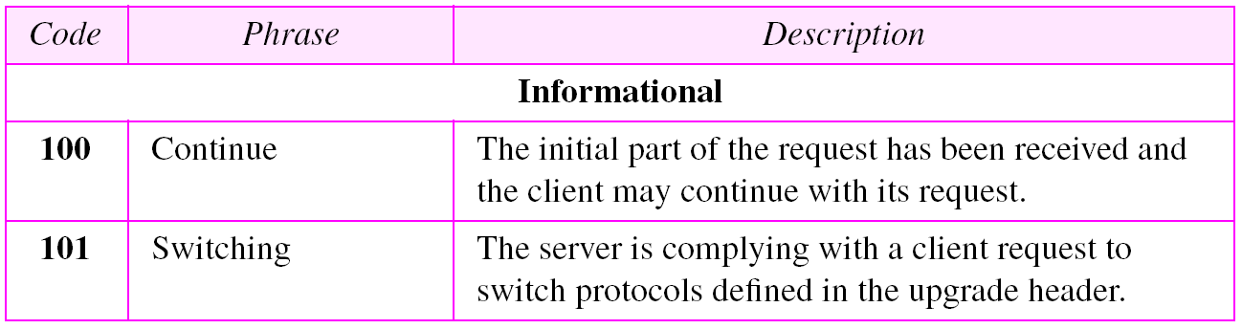
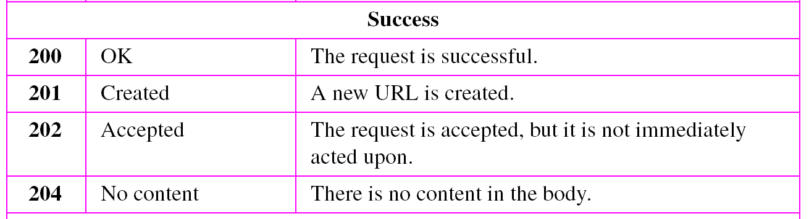
Table 22.2 Status codes

Slide 14
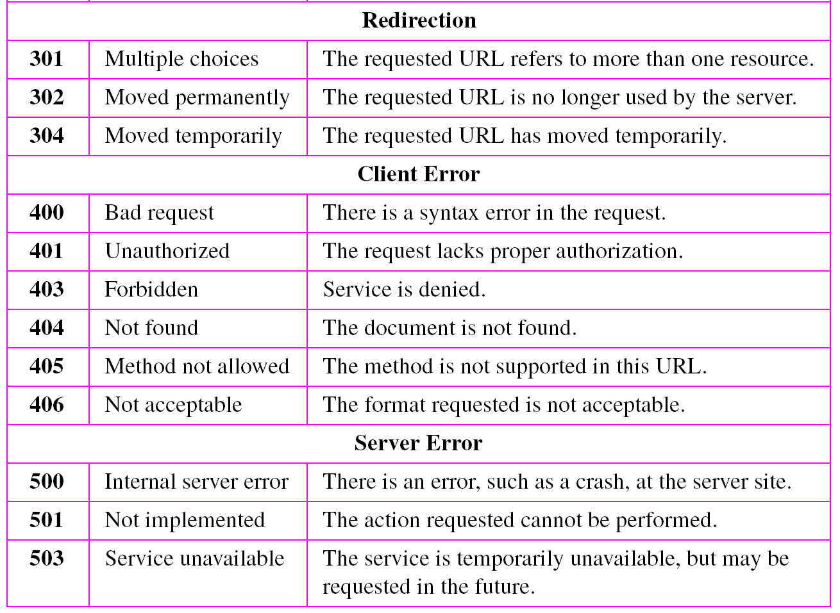
Table 22.2 Status codes (continued)

Slide 15
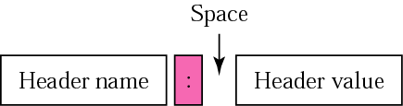
Figure 22.15 Header format

Slide 16
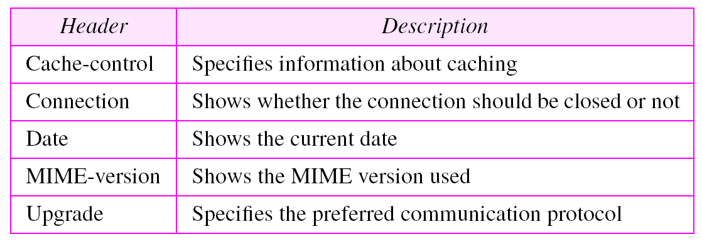
Table 22.3 General headers

Slide 17
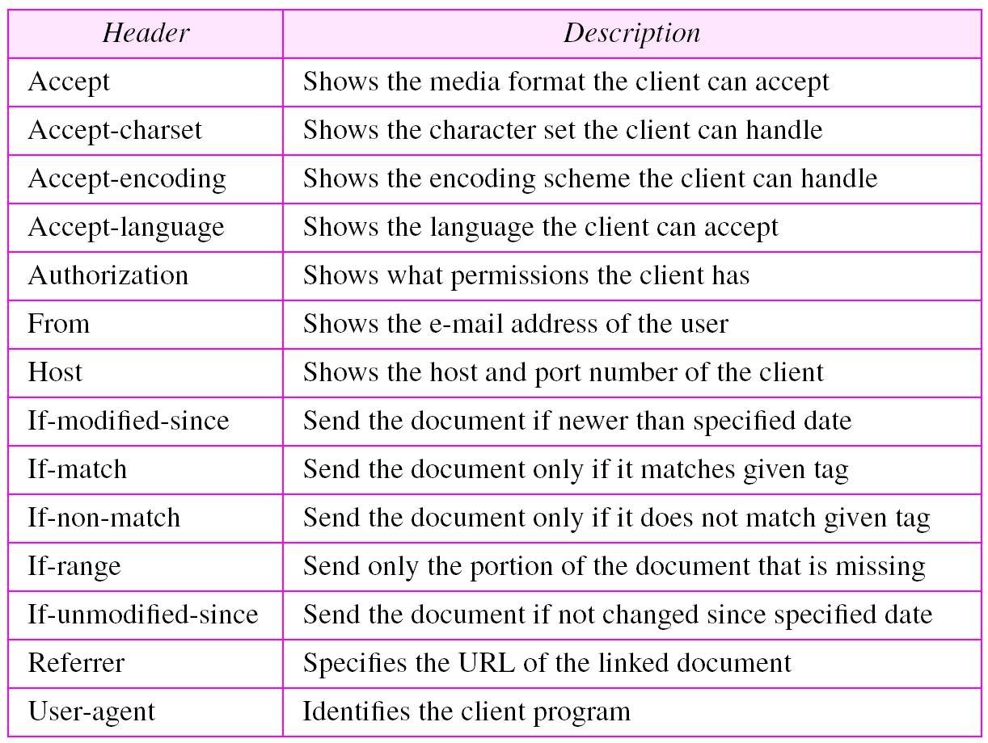
Table 22.4 Request headers

Slide 18
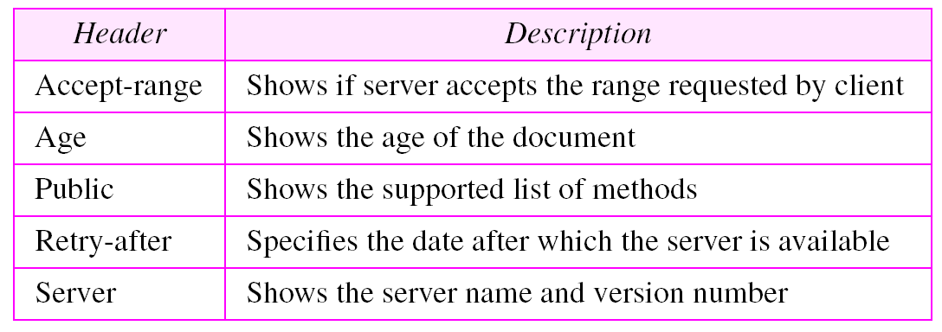
Table 22.5 Response headers

Slide 19
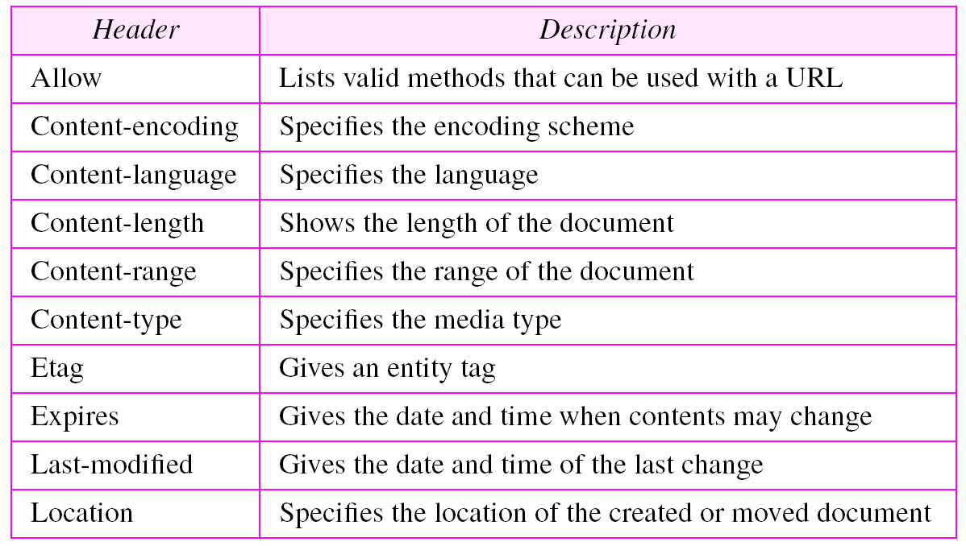
Table 22.6 Entity headers

Slide 20
Example 1
This example retrieves a document. We use the GET method to retrieve an image with the path /usr/bin/image1. The request line shows the method (GET), the URL, and the HTTP version (1.1). The header has two lines that show that the client can accept images in the GIF or JPEG format. The request does not have a body. The response message contains the status line
and four lines of header. The header lines define the date, server, MIME version, and length of the document. The body of the document follows the header (see Figure 22.16).

Slide 21
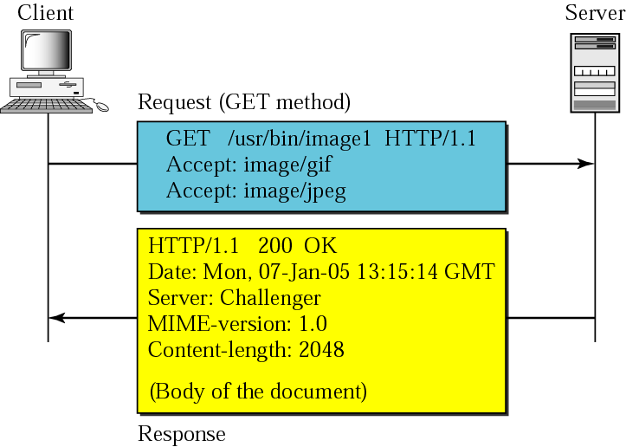
Figure 22.16 Example 1

Slide 22
Example 2
In this example, the client wants to send data to the server. We use the POST method. The request line shows the method (POST), URL, and HTTP version (1.1). There are four lines of headers. The request body contains the input information. The response message contains the status line and four lines of headers. The created document, which is a CGI document, is included as the body (see Figure 22.17).

Slide 23
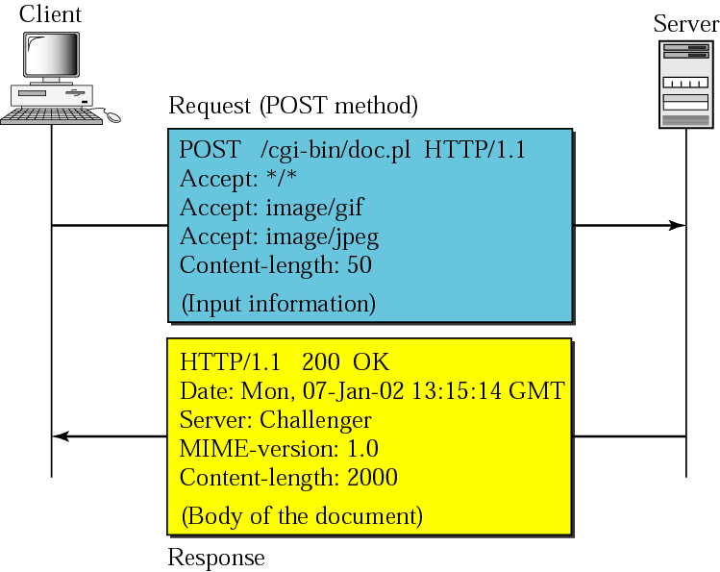
Figure 22.17 Example 2

Slide 24
Example 3
HTTP uses ASCII characters. A client can directly connect to a server using TELNET, which logs into port 80. The next three lines shows that the connection is successful. We then type three lines. The first shows the request line (GET method), the second is the header (defining the host), the third is a blank terminating the request. The server response is seven lines starting with the status line. The blank line at the end terminates the server response. The file of 14230 lines is received after the blank line (not shown here). The last line is the output by the client.

Slide 25
Example 3
$ telnet www.mhhe.com 80
Trying 198.45.24.104...
Connected to www.mhhe.com (198.45.24.104).
Escape character is '^]'.
GET /engcs/compsci/forouzan HTTP/1.1
From: forouzanbehrouz@fhda.edu
HTTP/1.1 200 OK
Date: Thu, 28 Oct 2004 16:27:46 GMT
Server: Apache/1.3.9 (Unix) ApacheJServ/1.1.2 PHP/4.1.2 PHP/3.0.18
MIME-version:1.0
Content-Type: text/html
Last-modified: Friday, 15-Oct-04 02:11:31 GMT
Content-length: 14230
Connection closed by foreign host.

Slide 26
Note:
HTTP version 1.1 specifies a persistent connection by default.

